Slide 1

GROUP- 9
ANKITA SIRURMATH
ASMITA SHETTY
SHREYA KOLEKAR
SIDDHESH CHAVAN
SUMA NEDNURKAR
SWAPNITA MANE

Slide 2
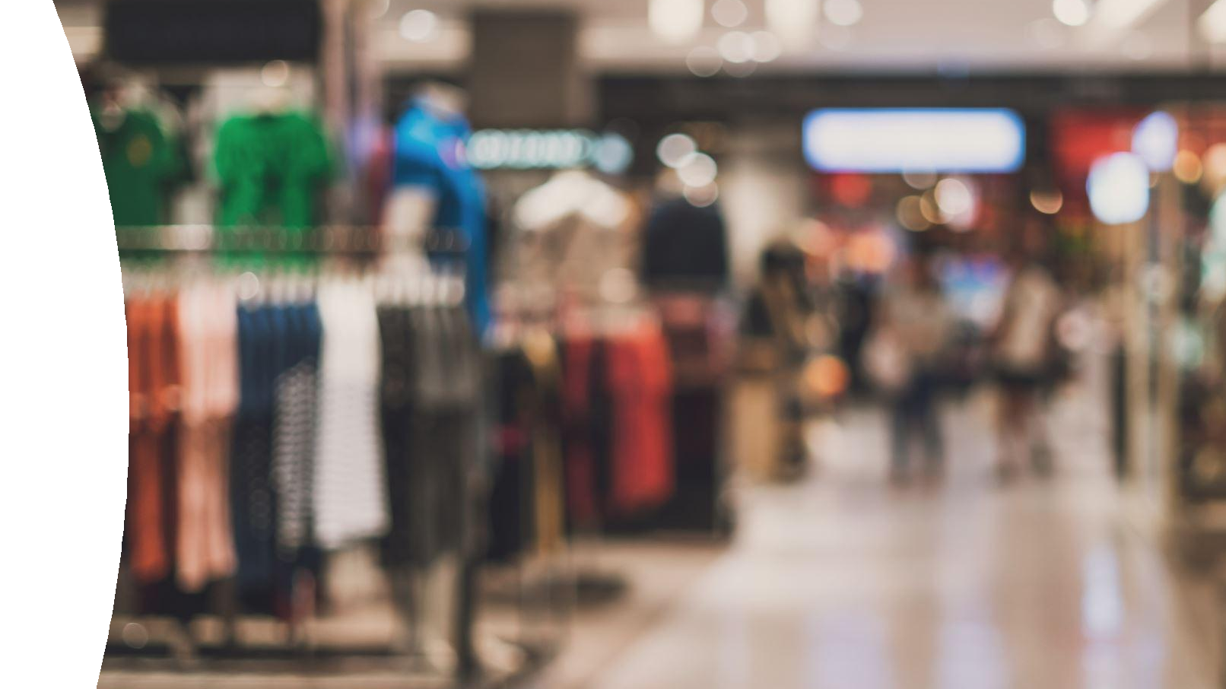
Online Shoppers’ Purchasing Intention

Slide 3
CONTENTS
PROBLEM DEFINITION
DATASET DESCRIPTION
EXPLORATORY DATA ANALYSIS
MODEL PREPARATION
RESULTS AND DISCUSSION
CONCLUSION

Slide 4
PROBLEM DEFINITION
“Can we forecast if a user will make a purchase on an
e-commerce website given their clickstream and session data?”
An answer to the fore-mentioned question is essential to find the profit-loss ratio of a virtual business and its commodity.
Data mining is the method utilized to extract valuable information.
Example: browser data, cookies, session data, page information, etc
We can discern the patterns of consumer purchase intentions.

Slide 5
DATASET DESCRIPTION
This dataset explores the shopper’s intention of purchasing products online
We have taken the dataset from https://archive.ics.uci.edu/ml/datasets/Online+Shoppers+Purchasing+Intention+Dataset
The dataset contains 12205 records and 18 columns.
This dataset includes information on the estimated levels of intentions biased in shoppers to shop for products online.
The data has no null values.

Slide 6
EXPLORATORY Data Analysis

Slide 7
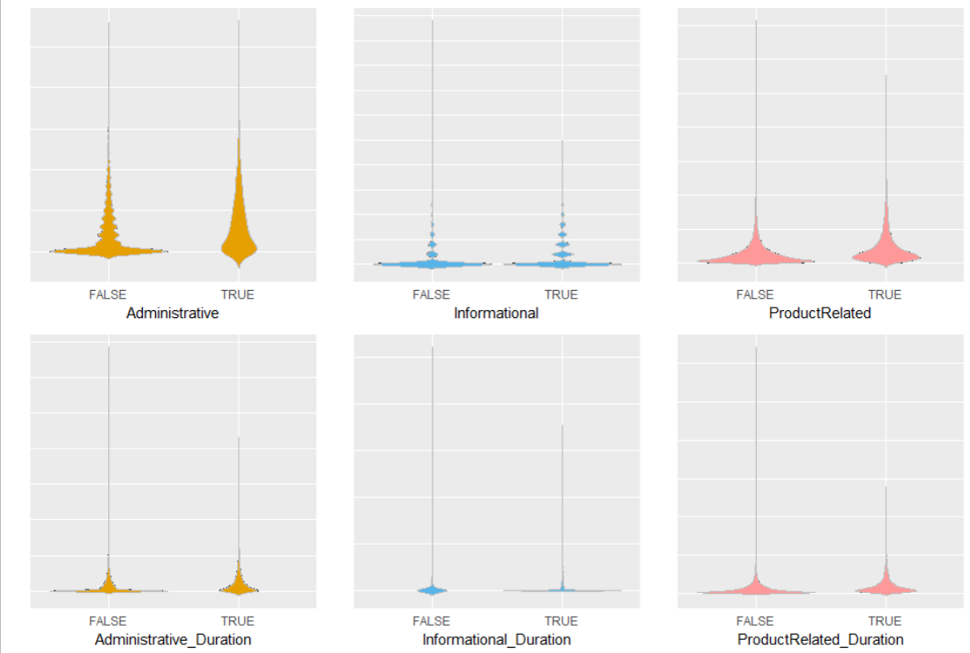
Page Type
No. of pages
Purchasing customers tend to spend more time on Administrative & Product Related webpages.
Less time on Informational
Visit duration
Insight ?
Notes:
Violin is a density plot.

Slide 8
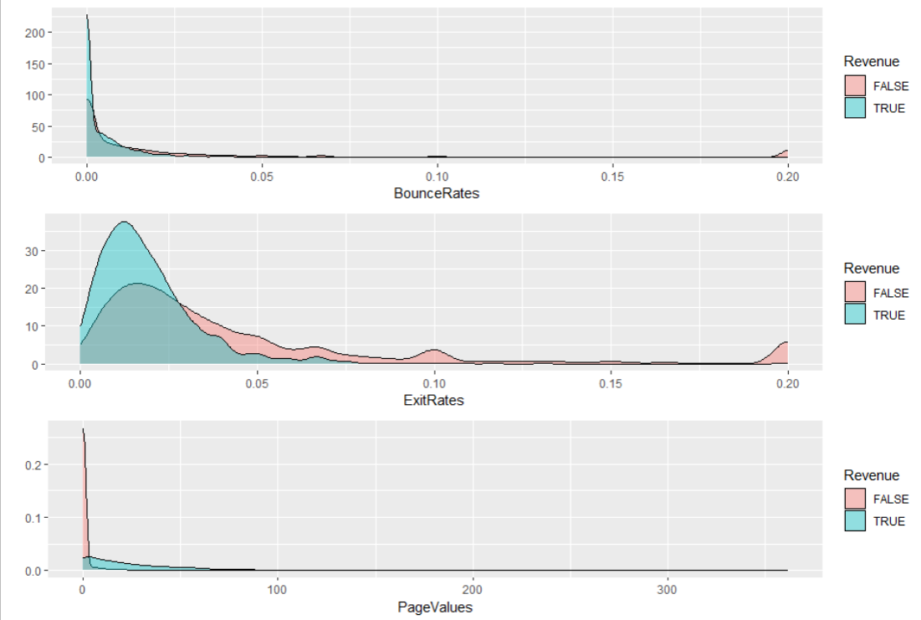
Page Metrics
Bounce Rates ↓
% of single-page sessions
Exit Rates ↓
% of visitors who left a website after viewing a particular page
Page Values ↑
average value of a page in terms of revenue
Notes:
Bounce Rate: measures the percentage of visitors who navigate away from a website after viewing only one page.
Exit Rate: measures the percentage of visitors who left a website after viewing a particular page.
Page Value: measures the average value of a page in terms of revenue. It is calculated by dividing the total revenue generated from a page by the number of unique pageviews.
Page value helps identify which pages on a website are contributing the most to revenue generation and can be used to optimize the site's sales funnel.

Slide 9
Special Days
1 : Special days
(Mother’s day, Valentine’s day)
0 : Regular days
0.x: Closeness to Special days

Slide 10
Month
Feb to Dec
Insight / Issues?

Slide 11
Visitor Type
New Visitor
Returning Visitor

Slide 12
Browser
Values 1 – 13
No specifics given

Slide 13
Region
Values 1 – 9
No specifics given

Slide 14
Operating System
Values 1 – 8
No specifics given
Majority are from one OS

Slide 15
Traffic Type
Values 1 – 20
Indicates the source from where the customer landed on the site
No specifics given

Slide 16
Insights and Recommendations
Most purchasing customers are returning customers
Collect contact information for targeted marketing like abandoned card email, promotion on item of interest etc.
Special days are not driving sales
Expand Special Days tracking to include more holidays and track the closeness to each holiday to improve on probing and offer triggers
Traffic Type 2 driving significant purchasing customers
Identify the traffic type. Understand what works/collect more info
Similarly identify OS and Browser 2 and collect more information on what works.

Slide 17
MODEL PREPARATION
Preprocessing.
- Scaling
- Removing Duplicate entries
- Removing NA values
The extracted features are fed as inputs to
- Decision Tree (DT)
- Support Vector Machines (SVM)
- K- Nearest Neighbour (KNN)
- Naïve Bayes classifier
Classification model with the best accuracy will be evaluated.
Insights and recommendations are based on exploratory data analysis and classification models combined.

Slide 18
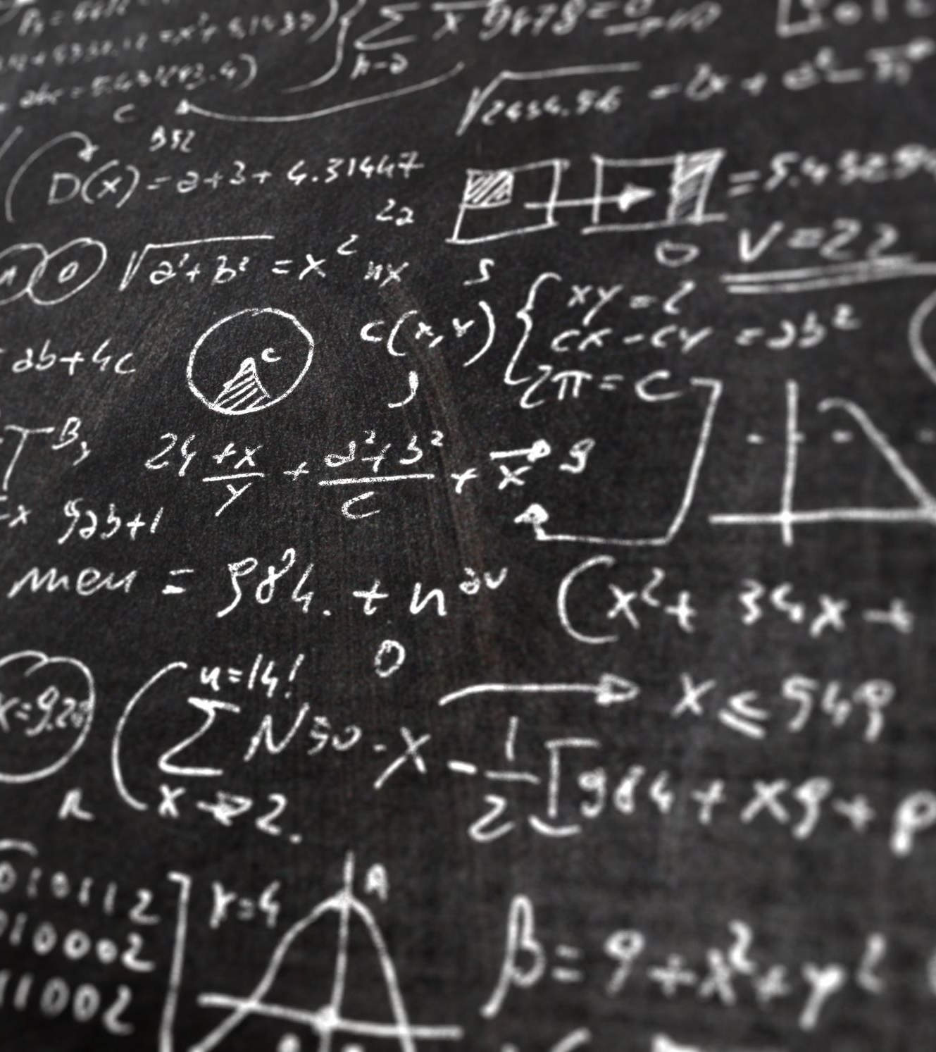
Naïve Bayes Classifier:

Slide 19
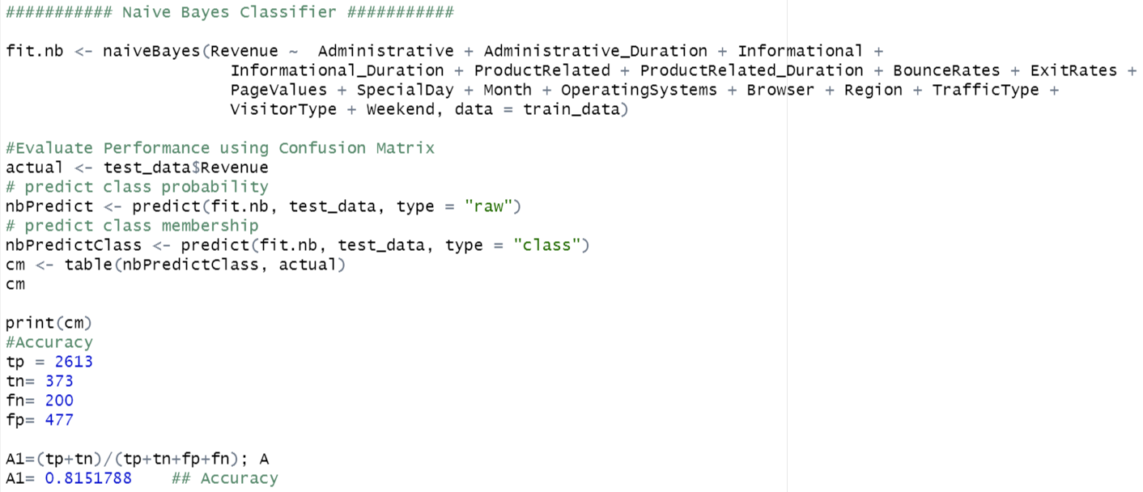
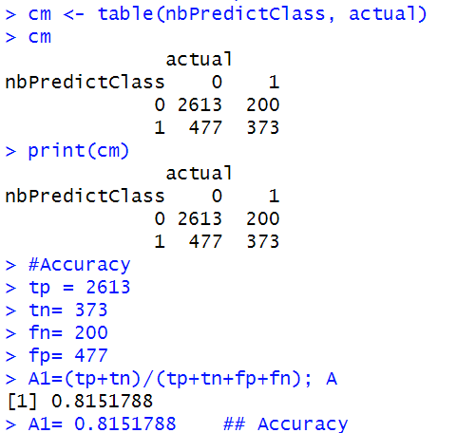
Output:
Code:

Slide 20
K - Nearest Neighbour
Notes:
The k-nearest neighbours algorithm, also known as KNN or k-NN, is a non-parametric, supervised learning classifier, which uses proximity to make classifications or predictions about the grouping of an individual data point.
It is typically used as a classification algorithm, working off the assumption that similar points can be found near one another.

Slide 21
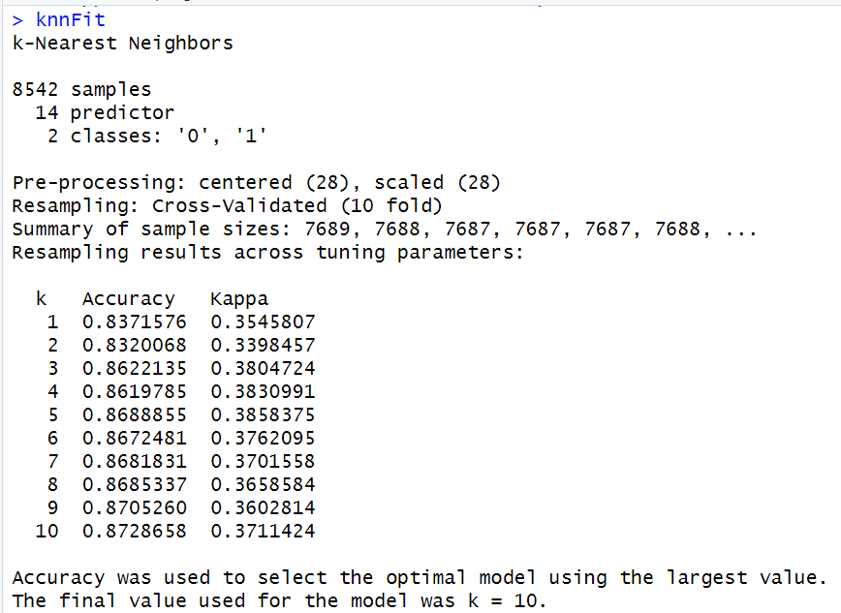
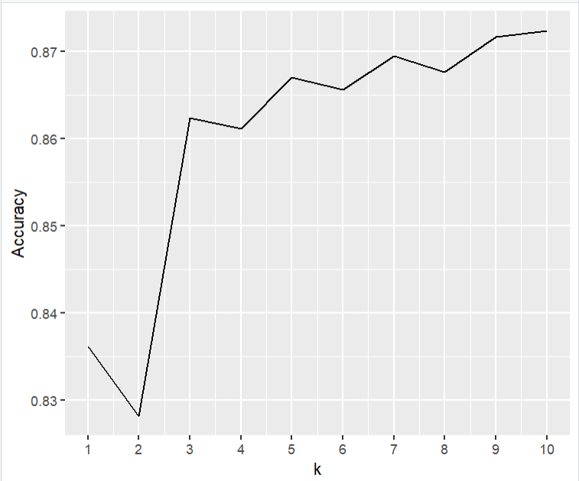
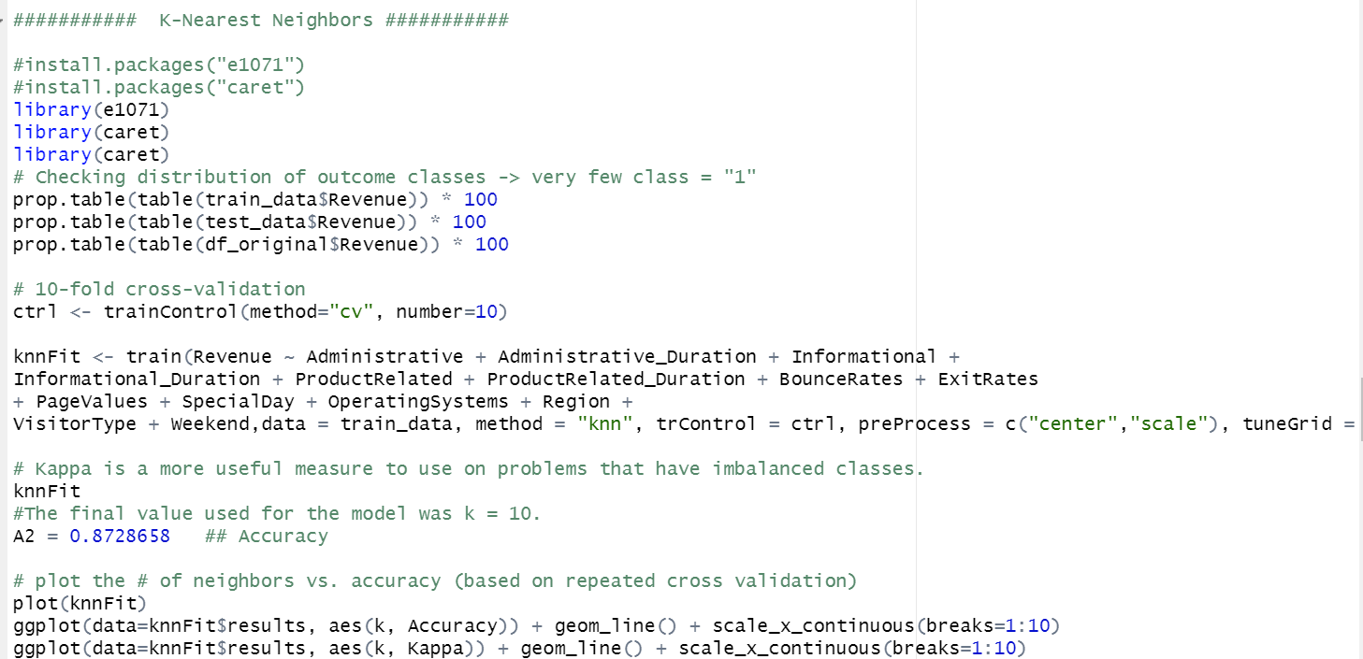

Slide 22
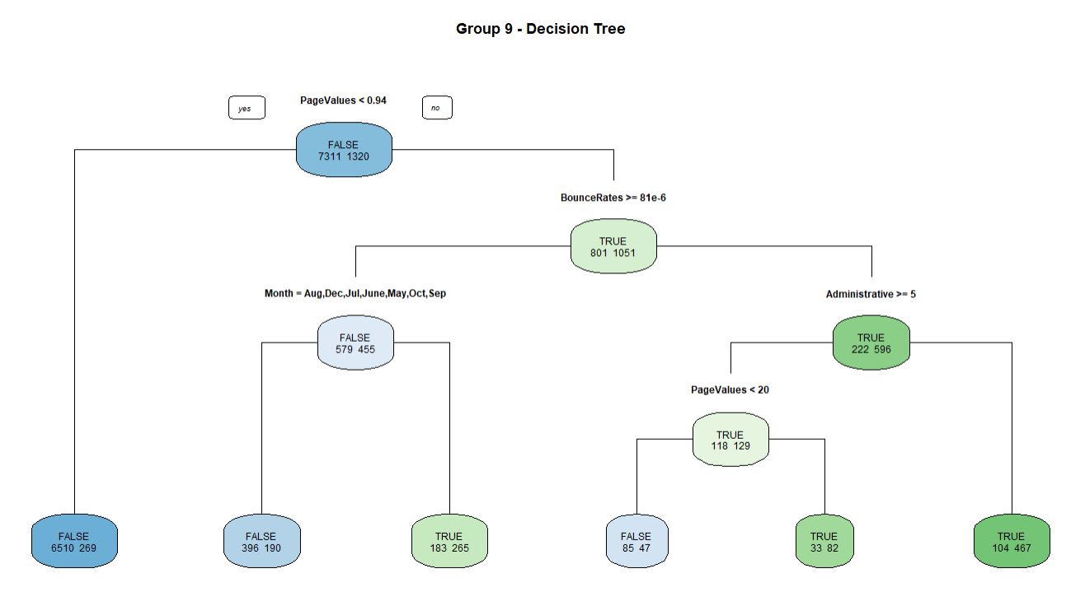
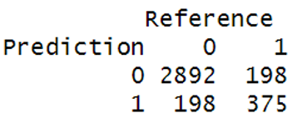
Tree-based Methods ____________ Decision Tree:
Accuracy: 0.8919

Slide 23

Support Vector Machine Algorithm:

Slide 24
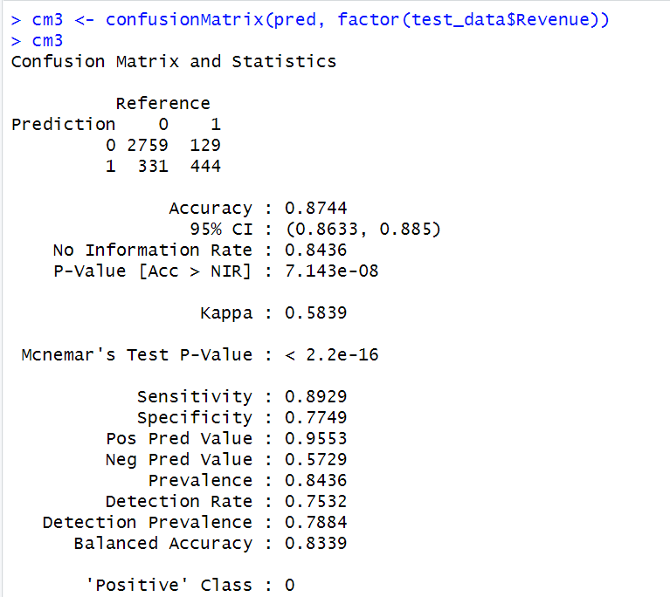
Linear SVM
Notes:
Linear SVM is used for linearly separable data, which means if a dataset can be classified into two classes by using a single straight line, then such data is termed as linearly separable data.

Slide 25
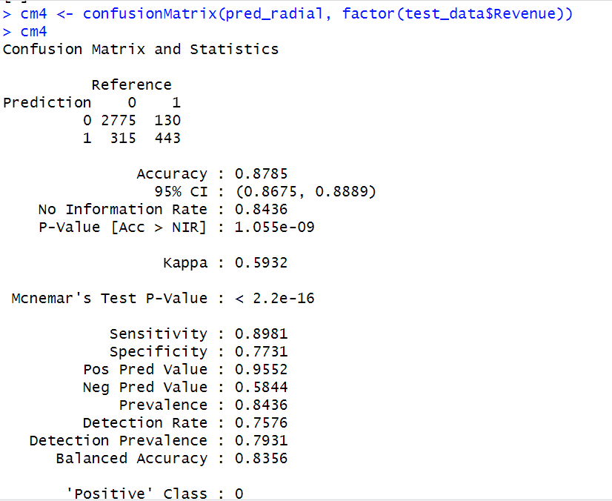
Radial SVM
Notes:
Radial support vector machine is used when the data is not linearly separable. The idea behind generating non-linear decision boundaries is to do some nonlinear transformations on the features Xi which transforms them into a higher dimensional space

Slide 26
RESULTS AND Conclusion
The extracted features are fed to all the classification models: decision tree, support vector machines (SVM), K- Nearest Neighbour (KNN), Naïve Bayes classifiers as input.
Oversampling and feature selection pre-processing steps are used to improve the performance and scalability of the classifiers.
Evaluation metrics: Using confusion matrix, the performance of the algorithms is compared using the accuracy.

Slide 27
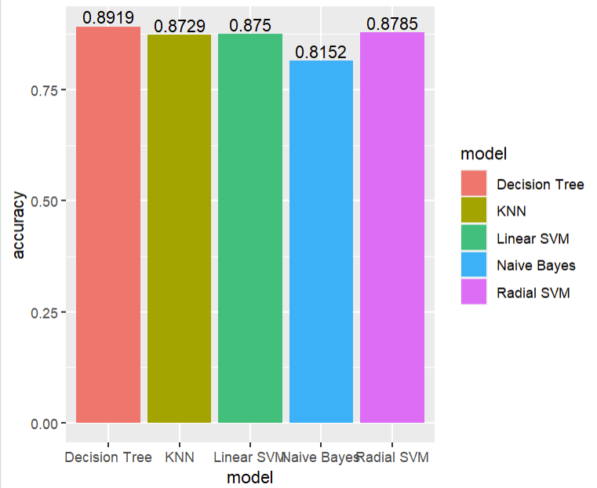

COMPARISON OF ACCURACIES BETWEEN DIFFERENT MODELS

Slide 28
Insights based on Decision Tree:
Reduce administrative overhead for checkout
PageValues is one of the most important attribute
Improve Product Related pages (vary minsplit)
Great opportunities in November

Slide 29

Thank you

